Slide 1
Automotive Companies Stock Volume Context with Tweets and News Articles
Presented by Harrison Kim, Steve Cozine, Christina Nguyen & Darrick Suen

Slide 2
Project Overview

Slide 3
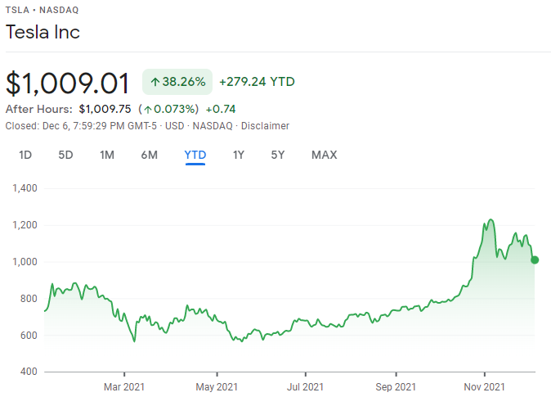
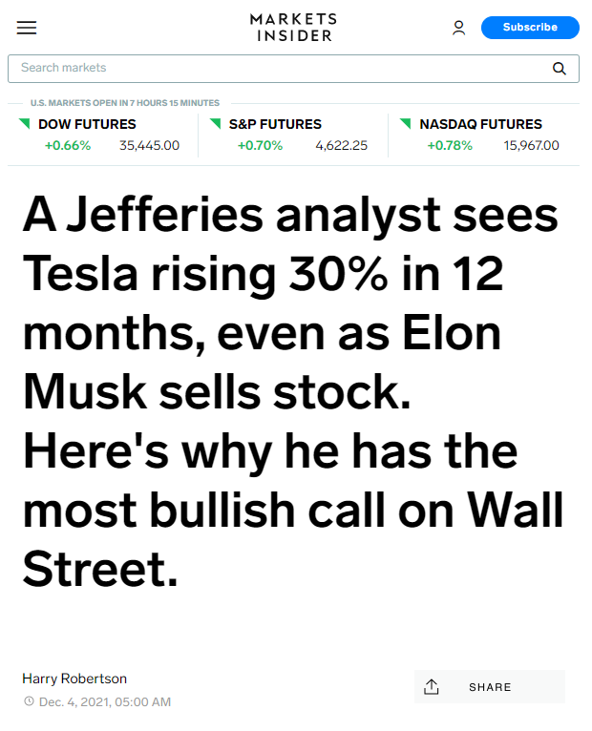
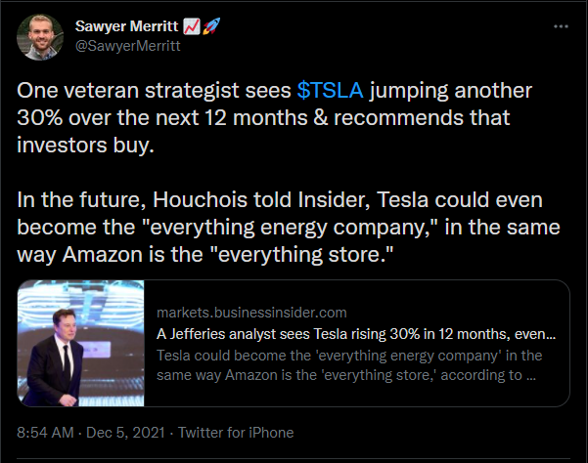

Slide 4
Project Details
Focused on automotive industry
Companies that have more than a year of stock data
Companies that are on the US stock market
Company list: Ford, Tesla, GM, Stellantis, Honda, Toyota, Ferrari, Tata Motors, NIO
Focused on these topics:
Earnings
New product/Product announcement
Supply chain
Investing analysis
Partnership announcement
Critique of company performance

Slide 5
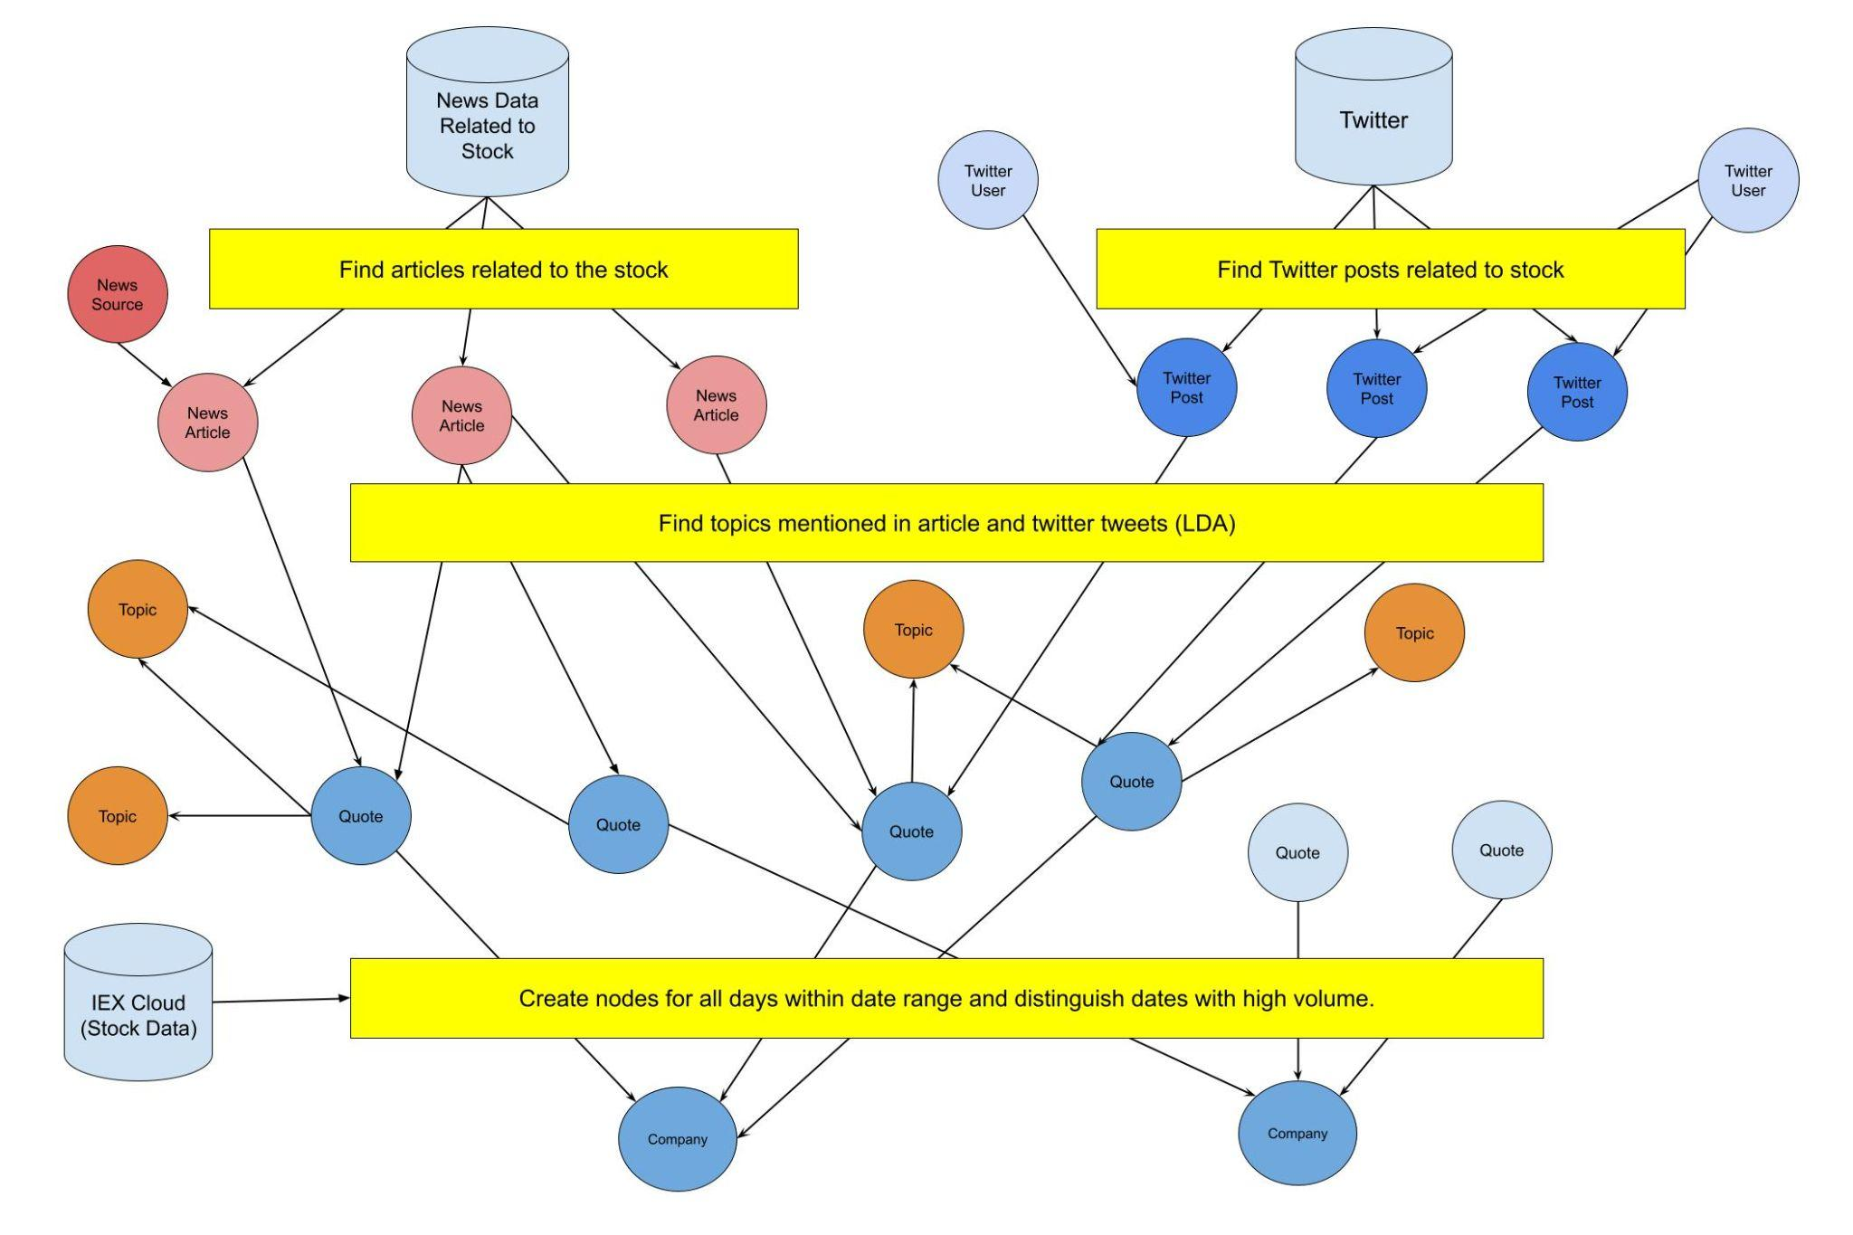

Slide 6
Data Sources

Slide 7
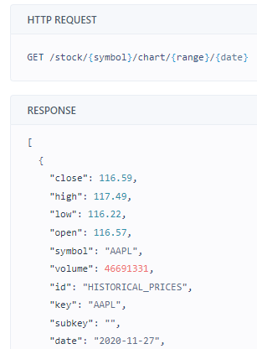
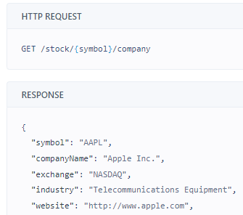
Stock Data
Pull stock data from IEX Cloud API in JSON format
Structured

Slide 8
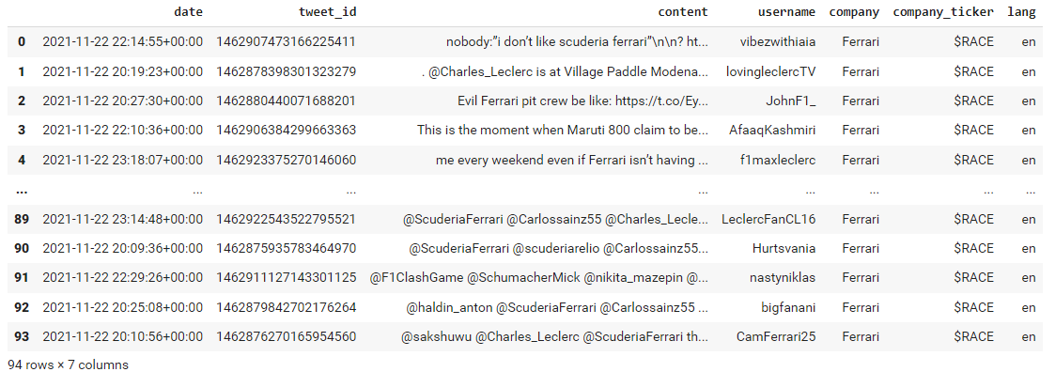
Tweet Data
Used package called snscrape to pull tweets for the days associated with the stock event
Semi-structured, but organized tweets into pandas dataframe
Notes:
Include example before string matching

Slide 9
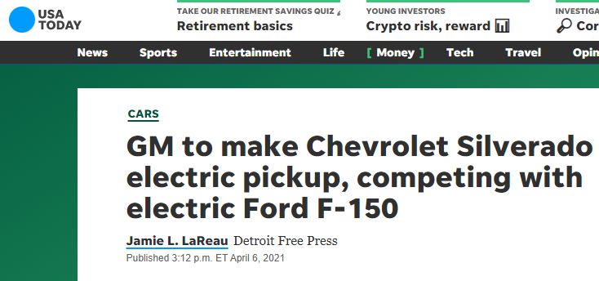
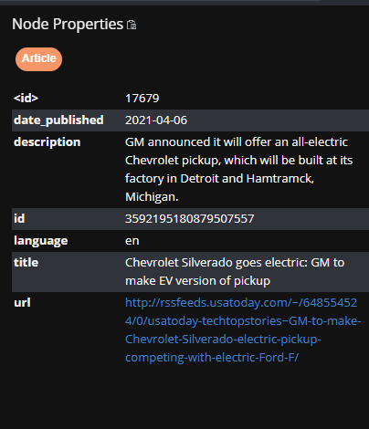
News Article Data
Used contextual web search API to pull news articles
https://rapidapi.com/contextualwebsearch/api/web-search
Semi-structured
Extracted: article title, article description, date published, website, URL
Querying filters:
Used list of top 40 news/financial sources like Forbes

Slide 10

Creation of Neo4j database
User Input
(Ticker, Start Date, End Date)
Node Creation Process
Stock Node -> Quote Node -> Article Node -> New Source Node -> Topic Node -> Tweet Node -> User Node -> Topic Node
Notes:
So I will start us off with how we set up our graph database
Very easy to use class that is our neo4j integrator
Topic nodes based on what we found with the articles and the tweets
If those nodes already exist it will create a relationship from those existing nodes
Because in each of these node create processes we are pulling from API’s and creating nodes, for this 11 month time free, it takes about 3-8 minutes to pull the whole tree for a given stock, of course depending on how many quote nodes are considered event nodes

Slide 11
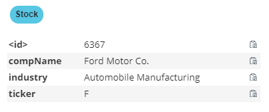
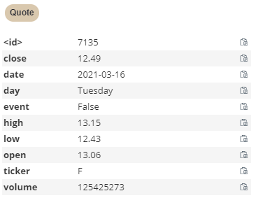
Stock & Quote Nodes
Stock Node
Properties
{compName, industry} - From IEX API given stock ticker
{ticker} - User Input
Quote Node
Properties
{close, date, event, high, low, open, volume} - from IEX API for every day in date range
{day} - Weekday that quote for stock occurred
{event} - True if volume of the node exceeds 2x the average of volume of the same weekday and stock, otherwise false
{ticker} - User Input
Notes:
For the Stock and quote nodes, the data was pretty well structured and no transformation was needed. We were able to simply pass the ticker to the API request and retrieve the company full name, the industry, and the daily pricing and volume.
The only data we had to look for was the day of the week the quote fell one, and the event property boolean which as discussed before was determined by if the volume of that day, exceeded 2x the volume of the average of that same weekday.
The reason we did this was because we found different days have different volumes in general, for example, Mondays and Friday typically have more volume because people are trying to close out their positions before the uncertainty of what could happen over the weekend, or open positions
We tried different multiplying factors, but 2x ended up being a sweet spot in returning the amount of results we desired.

Slide 12
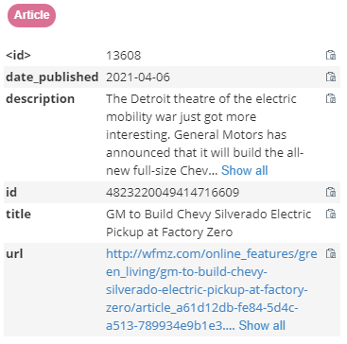
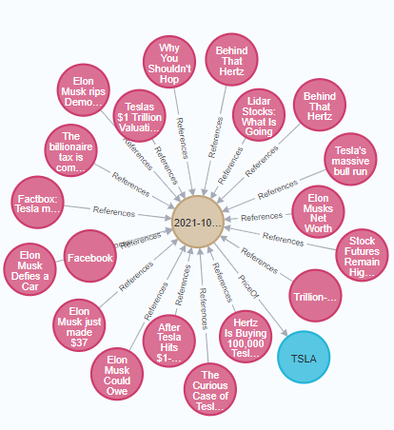
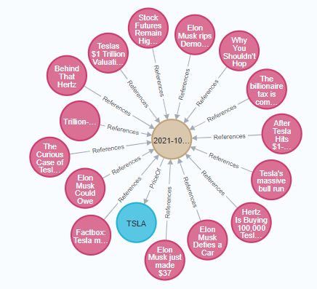
Article and News Source Nodes
Properties
{date_published, description, id, language, title, url} - From Article API
Transformation
Duplicate article removal
Removal of non ticker specific articles
Notes:
The articles were our first set of unstructured data. Our API was able to pull a large amount of articles given a keyword and timeframe, but even still we had to do some work before loading the parameters of those articles into our database.
Many of searches contained duplicate articles because in some cases the same article may have had different URL’s within the same domain, for some reason some sources posted their article multiple times, so we had to make sure to remove duplicate or almost duplicate articles. So although we could have done identical matching, to be safe we utilized using qgram (2) tokenization and cosine sim scoring to filter out duplicates.
Additionally, many of the articles that are pulled when searching for Tesla have very little to do with what you actually searched for. In the cases of the blue box, we found many articles that briefly mentioned the stock we searched for, but they were not mainly about that ticker. To resolve this, we performed a whitespace tokenization on the company name and scored it against what appears in the title or description of the articles and it actually worked pretty well.
On the left is what we got when we did not perform these transformations, and on the right we get a much better list.

Slide 13
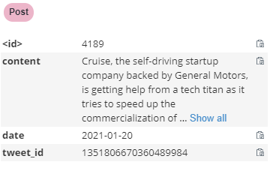
Post and User Nodes
Properties
{date_published, description, id, language, title, url} - From Snscrape API, using comp name
Transformation
Duplicate tweet removal
“Twitter and General Motors eyes #bitcoin, may expose their portfolio to the digital gold By BTC Peers #gold https://t.co/lSUtnBuV67 https://t.co/sPcf0als2c” (1359610650893447173)
“Twitter and General Motors eyes Bitcoin, may expose their portfolio to the digital #gold - https://t.co/CQN2aJw90y” (1359610621512327174)
“About 44,000 members of the United Auto Workers union will be getting $9,000 checks as a part of a profit-sharing agreement after General Motors brought in $9 billion in revenue in North America. https://t.co/VnWJpjXe5f” (1359612919802191874)
“About 44,000 members of the United Auto Workers union will be getting $9,000 checks as a part of a profit-sharing agreement after General Motors brought in $9 billion in revenue in North America. https://t.co/WmQIuCwkyS” (1359635894056157184)
“About 44,000 members of the United Auto Workers union will be getting $9,000 checks as a part of a profit-sharing agreement after General Motors brought in $9 billion in revenue in North America. https://t.co/tCHCb0e9YS” (1359622053473648642)
Notes:
The post nodes required a search which we provided the company name for.
The API provided a list of tweets which we used to create nodes.
The biggest issue we faced with tweets was that many of the ones we came across were duplicates. We felt it was okay if they just reinstated the headline of an article or the title of a video, but it seemed as if many accounts were bots that posted the same thing.
In this case we performed alphanumeric tokenization with cosine similarity scoring to search for duplicate tweets and remove them. You can see in the top example, they overall say the same thing, but you can see some difference like #bitcoin, and By BTC peers which is why string matching came in handy.
The reason we did this was because if there were many of the same tweet, and but did not pertain to the overall topic of that day, it could saturate the data and skew the classification for the topic node in our bag of words approach which Steven will describe on the next slide.

Slide 14
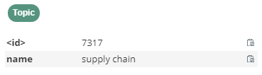
Topic Node
Properties
{name}
Transformation
Topic Modelling using LDA
Remove links and @Twitterhandles from Tweets
Conceptually, if we perform LDA on a set of Tweets/Articles from one day, we should be able to find the “topic” of that day
We apply this methodology to our stock event days
With a set of day-of-tweets we clean, tokenize, and lemmatize each tweet and combine all into a single list, then process into distinct topics using LDA (we generated 3 per day-of-Tweets)
Manually label a number of these topics (i.e. “Global”, “Chip”, “Semiconductor”, “Shortage” into “Supply Chain Topic”)
Combine topics of the same type by doing a full outer join on words, and combining the weights
Use these master sets to evaluate unlabelled Tweets from an event day with an inner join and combining weights
The max of the combined weights is the assigned topic
Repeat for article descriptions

Slide 15
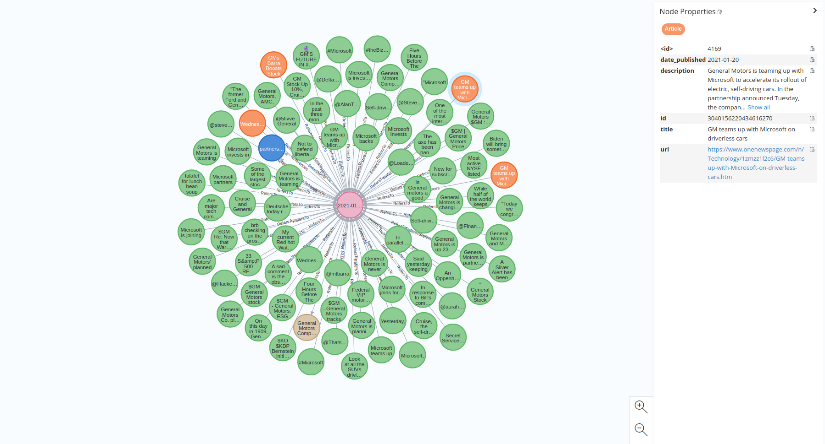
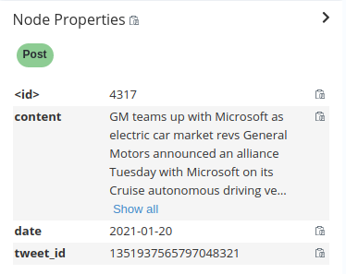
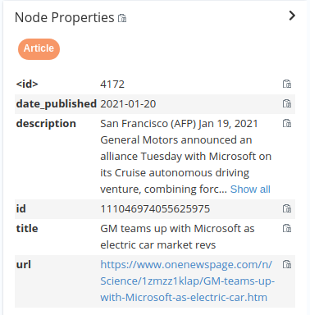
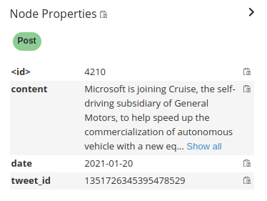

Slide 16
Demonstration of Graph and Report

Slide 17
Neo4j Queries
Search for specific Stock, Events, and Articles/Tweets
MATCH (s:Stock {ticker: 'F'})-[]-(e:Quote)-[]-(n) WHERE e.event = 'True' RETURN *
Search for Articles or Topics that Reference More than One Event Node
MATCH (s:Stock {ticker: 'F'})-[]-(e:Quote)-[]-(a:Article) WHERE e.event = 'True' RETURN *
MATCH (s:Stock {ticker: 'F'})-[]-(e:Quote)-[]-(t:Topic) WHERE e.event = 'True' RETURN *
Articles that Referenced Two or More Stocks
MATCH (s1:Stock)-[]-(q1:Quote)-[]-(a:Article)-[]-(q2:Quote)-[]-(s2:Stock) RETURN *
Stocks with Topics in Common
MATCH (s1:Stock)-[]-(q1:Quote)-[]-(t:Topic)-[]-(q2:Quote)-[]-(s2:Stock) RETURN *
All Articles from a Specific Source
MATCH (so:Source{name:"reuters"})-[]-(a:Article)-[]-(n)-[]-(s:Stock) RETURN *

Slide 18
Lessons Learned & Future Work
Introduction to determining topics from LDA
How to prototype graph schemas before implementation
Creating a neo4j graph with tweets, articles, and connected with stock events
Addressing challenges with filtering text data from different sources
Automate model training
Pulling more years of stock
Improving topic model
Implement further parallelization to speed up API requests, graph creation
Try on different industries
Drawing more conclusions on analysis

Slide 19
Q&A

